Slide 1

SELF-SERVICE TUTORIAL

Slide 2

The following topics are covered:
Plan and schedule courses
Register for classes
Print your registration statement and schedule
How to access Student Planning
View Financial Aid

Slide 3
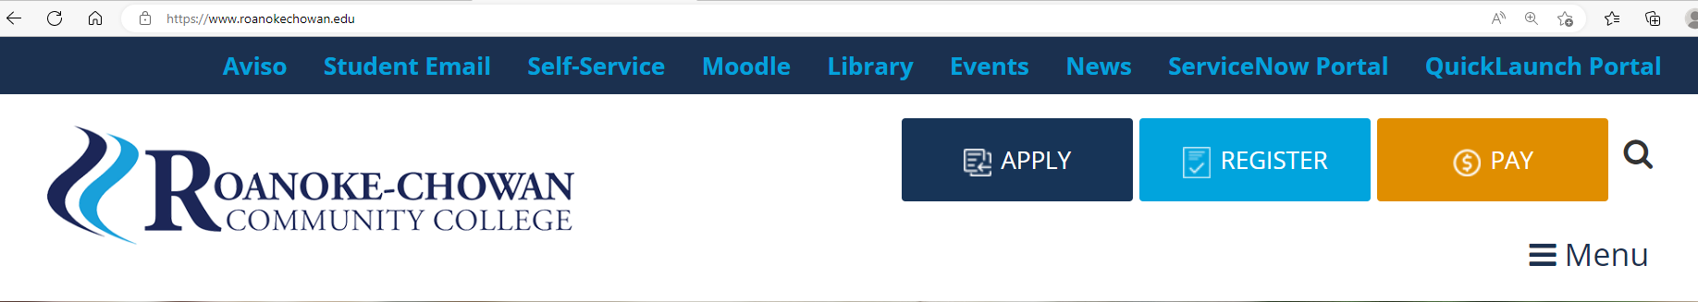
How to access Student Planning
From the Roanoke-Chowan Community College homepage, www.roanokechowan.edu, click Self-Service on the top banner.

Slide 4
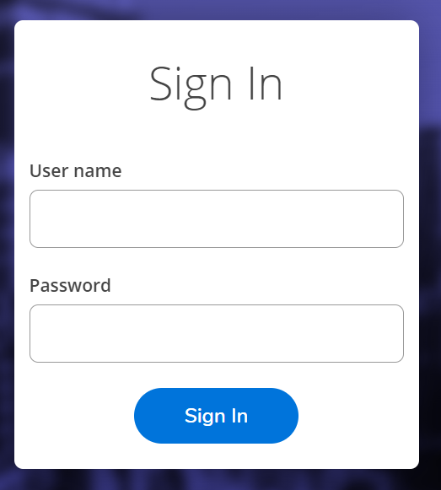
At the Ellucian page, enter your Roanoke-Chowan Community College Username and Password to log in.

Slide 5
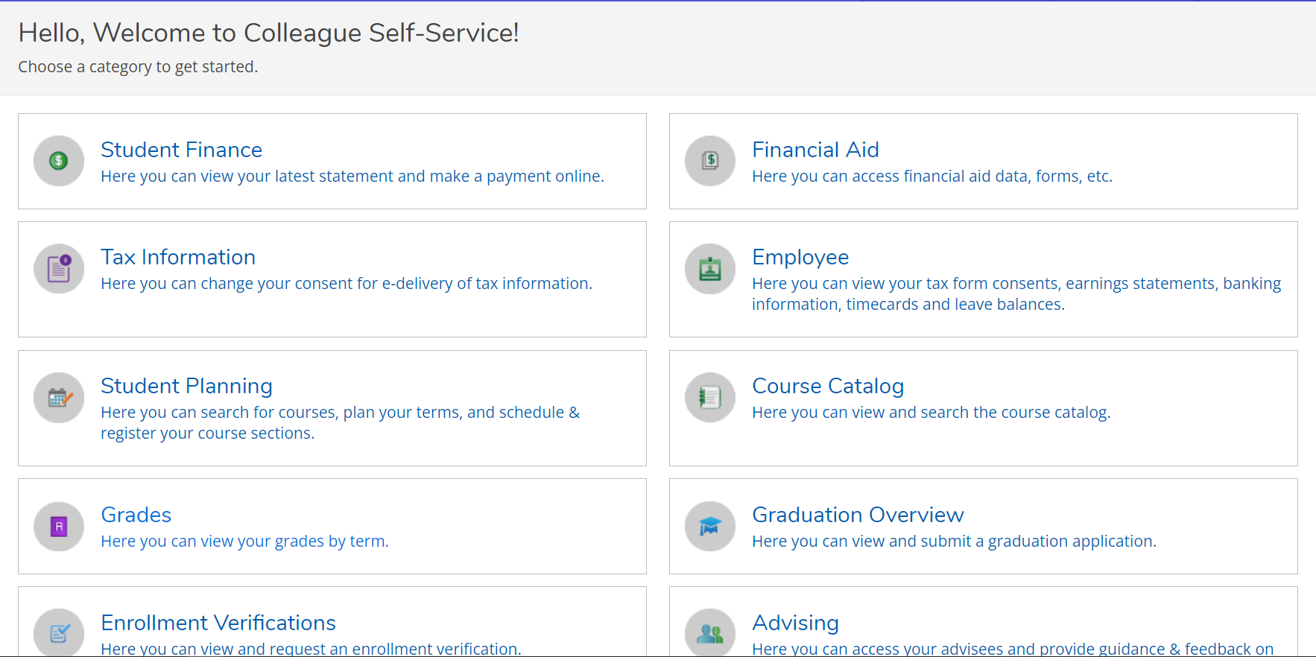
At the Self-Service landing page, select Student Planning

Slide 6
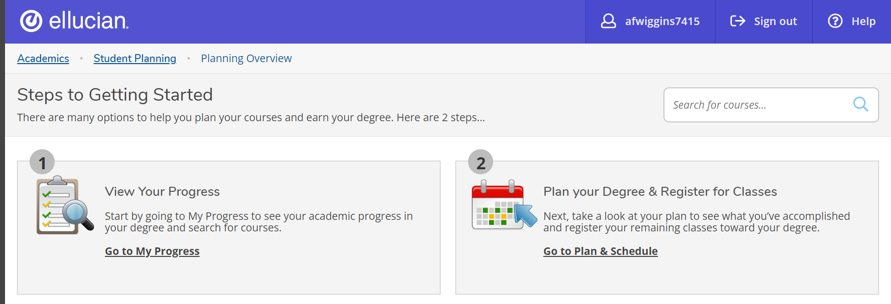
Plan and Schedule Classes
There are multiple ways to view course options for a semester, but for this tutorial, I will show you the steps ‘View Your Progress’ and ‘Plan your Degree & Register for Classes’.

Slide 7
My progress
To see what courses you can take, choose Go to My Progress.

Slide 8
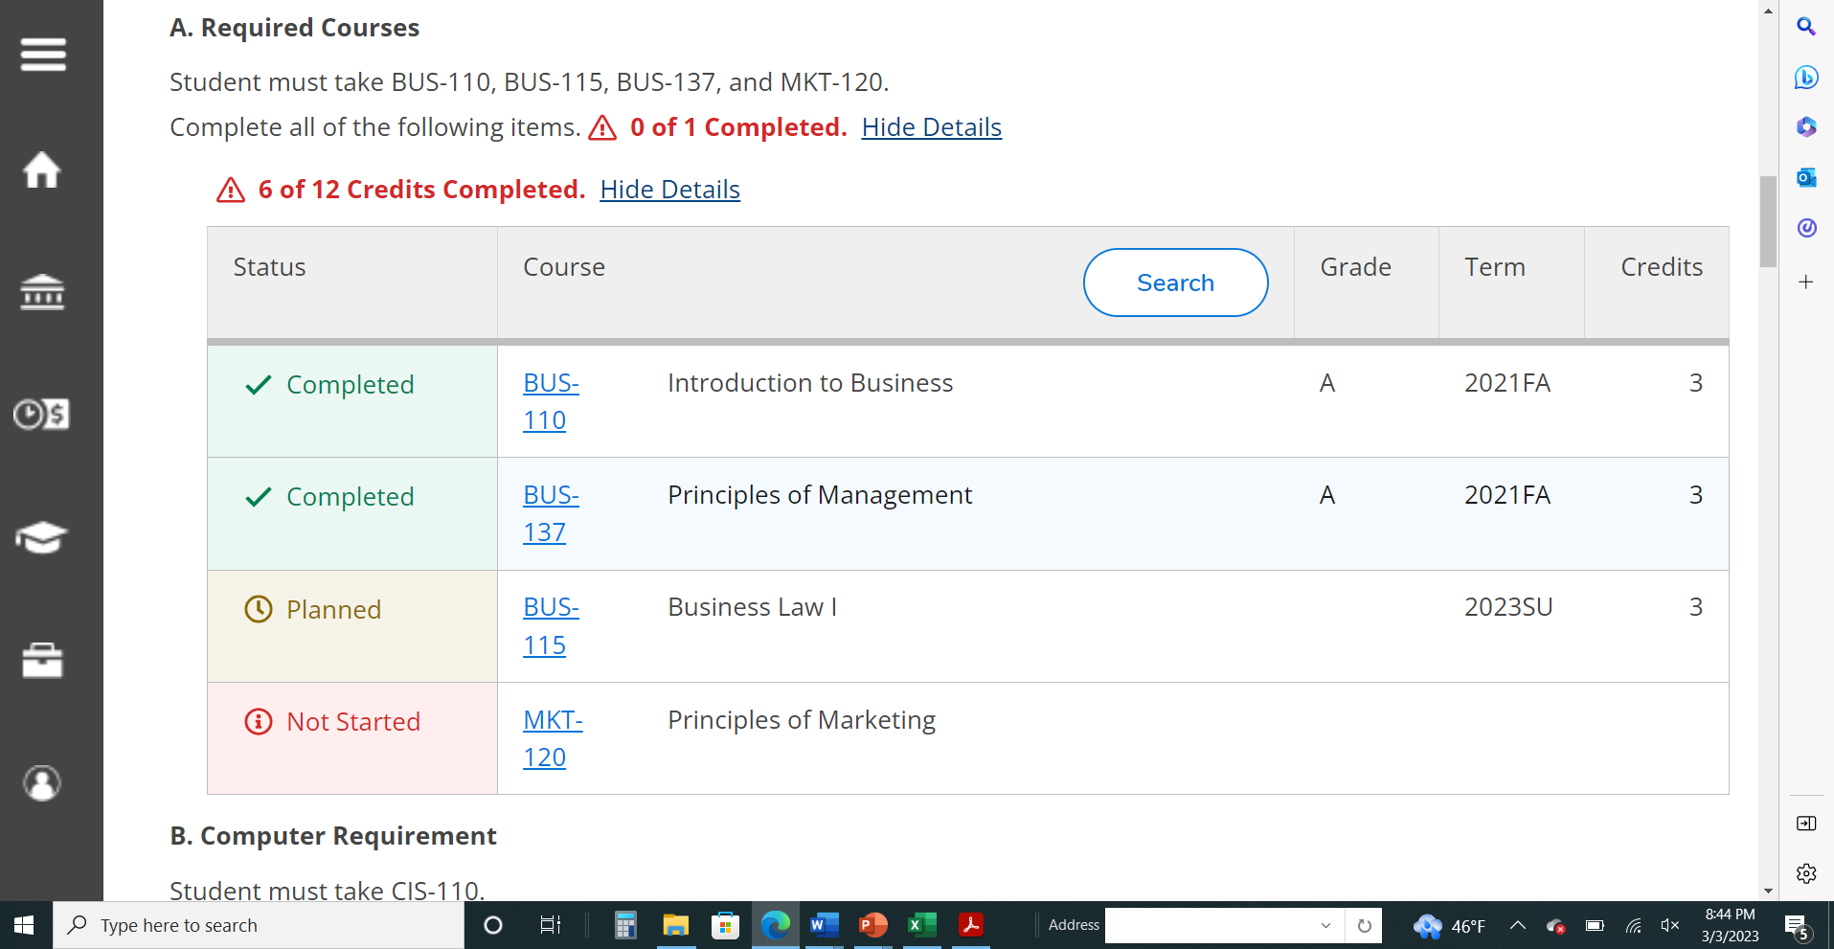
As you scroll down My Progress you will see the courses you have to take to complete your program.
Green means that the course credit is complete or in progress
Yellow means that the course credit has been planned or registered for in the future
Red means that the course credit has not been started

Slide 9
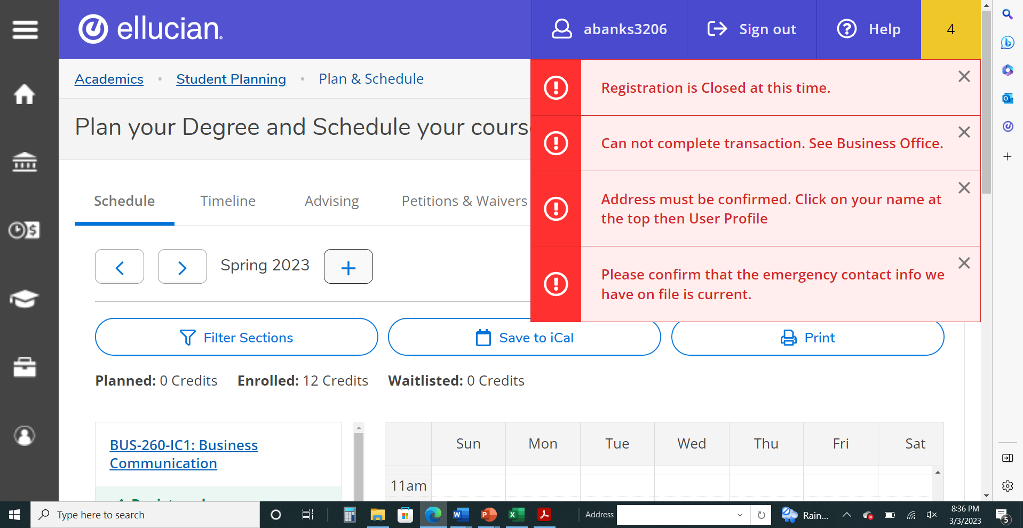
Notifications: Check to see if you have any notifications
If you have any holds on your account or updates that need to be resolved, you will see alerts in red on the top right of screen. Please contact Student Services if you need help with what to do.

Slide 10
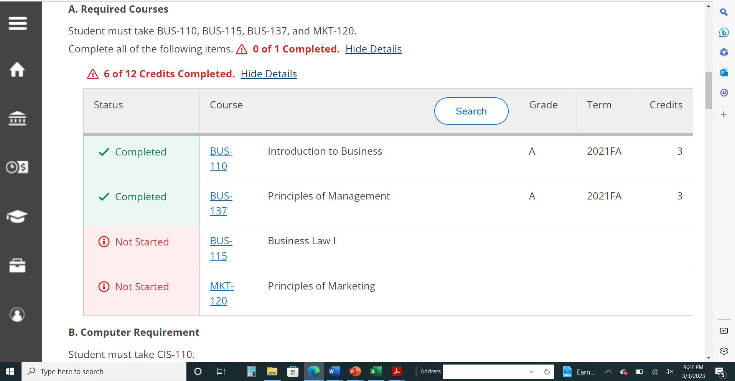
Select the course you would like to take by either selecting on the specific course under the Course column or seeing all the course options by selecting Search. For this tutorial, I am looking to take BUS-115, which has not started. You will have different courses to select.

Slide 11
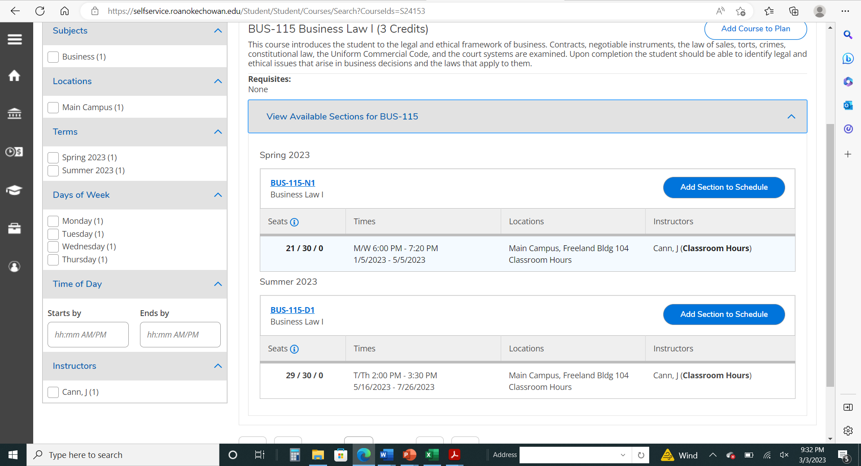
After selecting on the Course (Ex. BUS-115) you will be directed to the Course Catalog to view the course details and available sections. Select on ‘View Available Sections for BUS-115’ to expand all the available options for this course. Pay attention to the semester that the class is offered, the start date, the meeting times and the location of the class to find one that meets your needs. Select the ‘Add Section to Schedule’ button.

Slide 12
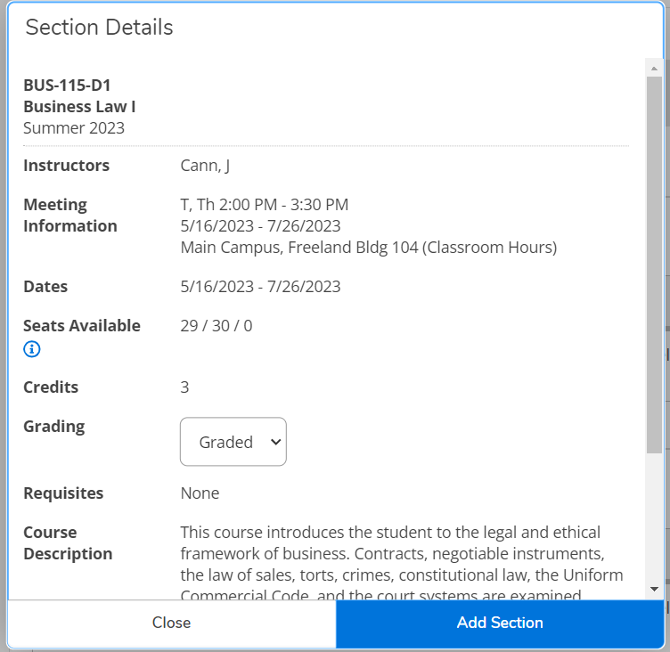
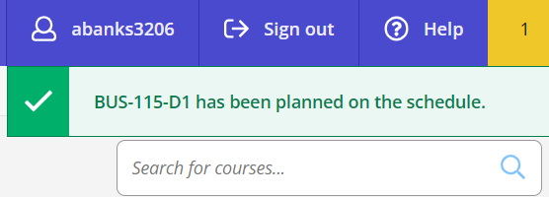
A popup window opens with the section details. Select on ‘Add Section’ to add the course to your planned schedule. You will get a confirmation box at the top that it has been planned.

Slide 13
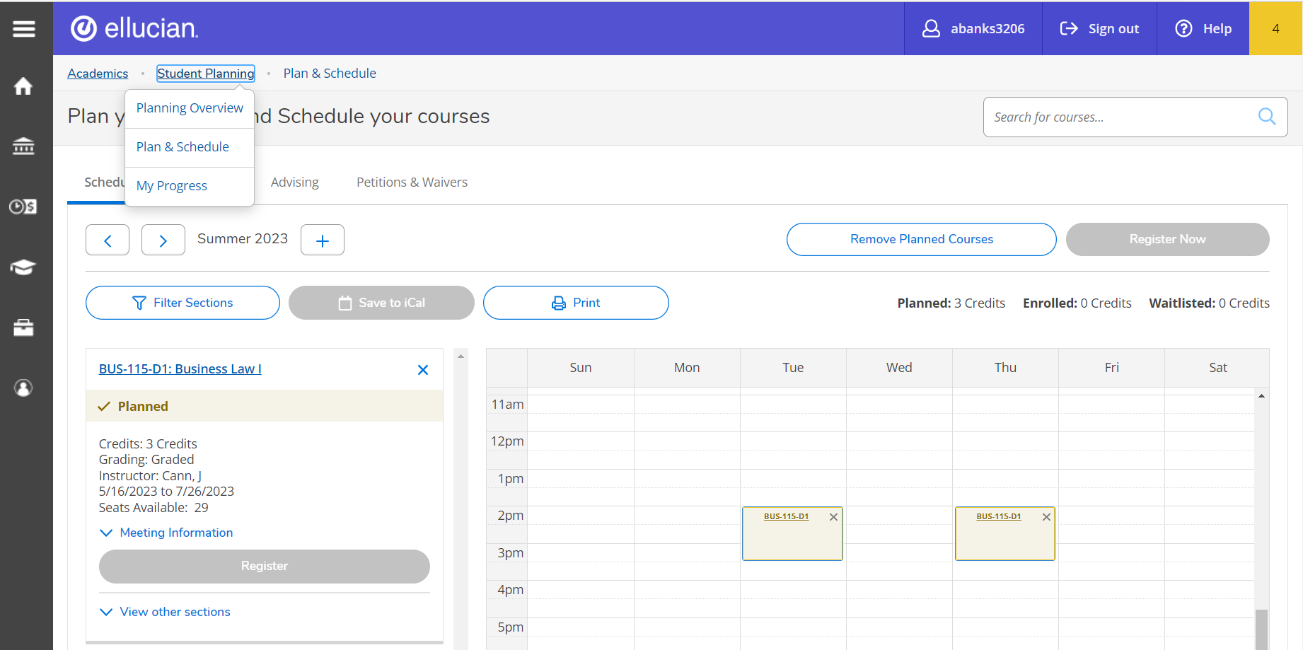

Planned courses must be approved by your Advisor before you can register. Step 2 – Request Review of Planned
Once sections have been added to your schedule, the next step is to send a request to your Advisor to review and approve the planned courses. Go to the ‘Student Planning’ drop down menu and select ‘Plan & Schedule’.
Then select the Advising tab and Request Review. This will also list who your Advisor is.
Go to ‘My Progress’ and you will now see that the status has changed to Planned. You can repeat the process to add additional courses to your planned schedule.

Slide 14
Planned courses must be approved by your Advisor before you can register.
Once sections have been added to your schedule, the next step is to contact your advisor to review and approve the planned courses and register you.
Request Review of Planned Course(s)

Slide 15
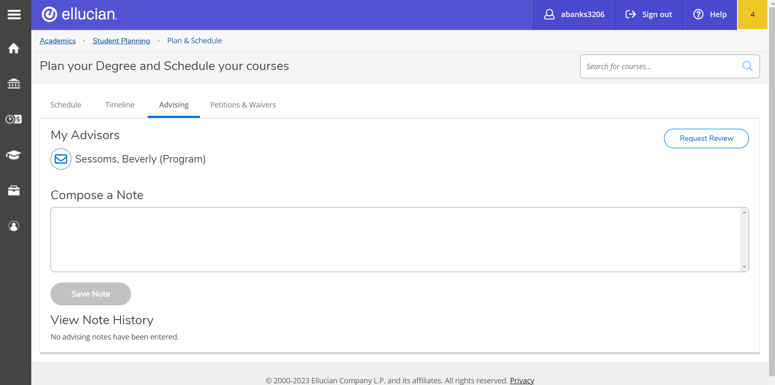
Go to the ‘Student Planning’ drop down menu and select ‘Plan & Schedule’, then select the Advising tab. This will list who your Advisor is. Click on the email icon next to your advisor’s name to send them a message. You should also click on Request Review. Your advisor will go in and Approve the courses. If a course is not in your program, they will respond requesting further details as to why you want to take it. Note - Financial Aid does not cover courses not in your program and taking a course not in your program will not help you complete your program.
After your Advisor completes the review, you now move on to registering for classes.

Slide 16

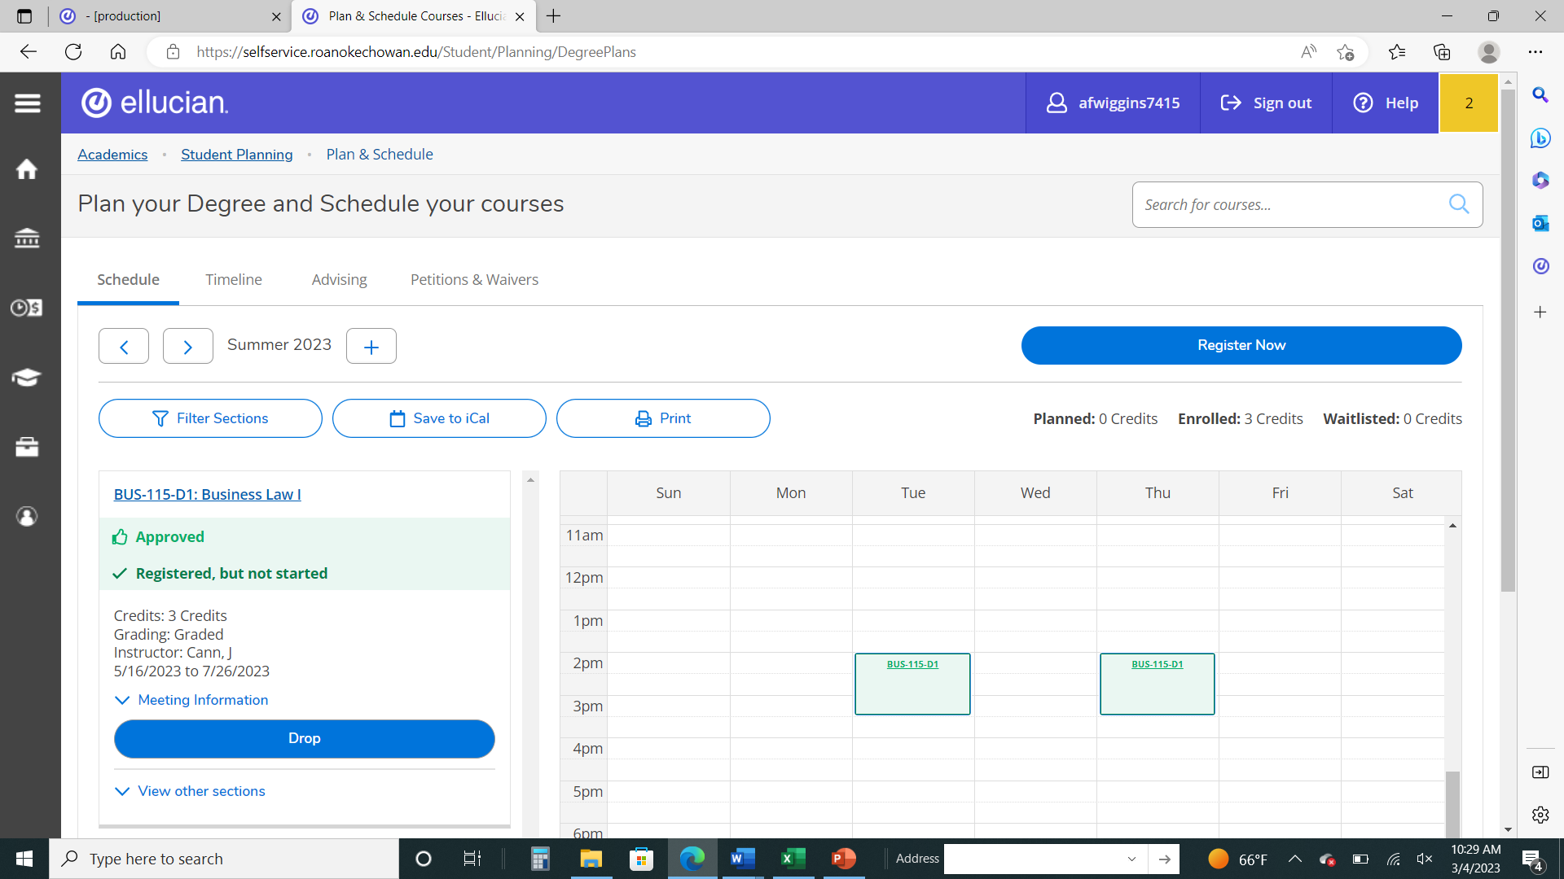
How do I know when my classes are registered?
Registration is complete when the class(es) is green.

Slide 17
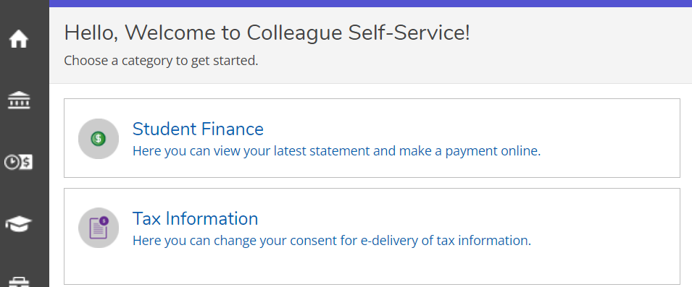
View and Print Registration Statement/Schedule
Select the HOME button at any time to take you to the main menu.
Next, select the student finance box to view and print your schedule and tuition statement.
(You will only be able to view and print if you are registered for classes)

Slide 18
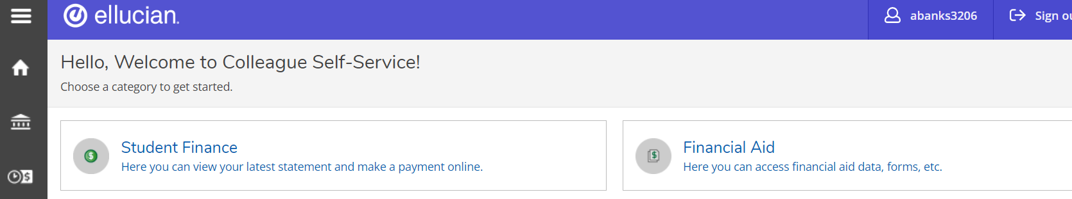
View Financial Aid Information
For students who receive financial aid only
Select the Home button to return to the main menu. Select the Financial Aid box.
From here you can manage your financial aid information and accept your award letter.

Slide 19

Questions???
Contact Student Services at (252) 862-1200

