Slide 1

The QEP and Advising

Slide 2
QEP-Quality Enhancement Plan
The QEP aims to enhance student success through improved onboarding and advising, guiding students in choosing, entering, and completing their academic pathways at R-CCC.
RCCC’s QEP Model – (CAPS) ‘Career-Advising-Path-Success’ will support student success, retention, and completion, with implications for overall learning
QEP Fact – R-CCC is accredited by (SACSCOC) the Southern Association of Colleges and Schools Commission, which requires the college to submit a QEP as a part of the accreditation process
Split Model of Advising – Students start with a professional advisor at the advising office and are assigned to a faculty advisor mid-way through the first semester

Slide 3
Role of Advisors in Student Success
Advising at R-CCC is intrusive, proactive and student-centered, focusing on transformational growth beyond course selection.
Professional Advisors (assigned at enrollment) track student progress in Aviso (Watermark SS&E) and collaborate with faculty advisors. They must attend two advising PD sessions annually and are encouraged to join program advisory meetings.
Faculty Advisors (assigned after the first semester) guide students in career awareness, academic resources, and document key advising points in Aviso (Watermark SS&E). They must attend at least two advising PD sessions per year.

Slide 4
Proactive & Intrusive Advising
Proactive and intrusive are often used synonymously
Proactive - advising aimed at all students, to demonstrate concern and care for students, strategically providing them with information, and helping them to avoid problems
Intrusive - traditionally used to refer to a targeted program designed to support at-risk student populations and initiatives designed to support at-risk student populations such as first-year, first-generation, or academically at-risk students
Research has found the Proactive (Intrusive) Advising Model enhances student motivation and increases class attendance, retention, and the number of credit hours completed per semester

Slide 5

Updated Advising Manual

Slide 6
Advisor Responsibilities
Utilize Resources – Refer to the Advising Manual, R-CCC Academic Catalog, and NACADA resources for guidance.
Focus on the Student
Learn Names
Respect Confidentiality
Observe Verbal & Nonverbal Cues
Ask “Why?”
Use Open-Ended Questions
Be Available
Know Policies
Learn Campus Resources
Provide Accurate Information – Never guess
Set Limits
Embrace Technology
Notes:
As an advisor, you should utilize all the resources available to you. These include the Advising Manual, R-CCC Academic Catalog, and policy and procedure manuals as needed. Advisors are also encouraged to use the twelve advising tips from the National Academic Advising Association (NACADA) and other NACADA resources available on their website.
It is not about you. Avoid using the first-person singular. Instead, draw students out by asking them to articulate their thoughts, ideas, and points of view.
Know their names. There is nothing sweeter than the sound of our own names, so learn the names of advisees and use them. Doing so will create a warm, open atmosphere conducive to productive conversations.
Be respectful of your advisees. Remember to be careful with information they disclose and follow the legal guidelines which are meant to encourage student independence. Determine your campus legal resources and ask questions regarding confidentiality.
Listen to verbal and nonverbal cues. What students say is sometimes not what they really mean. Be alert to the non-verbal cues that body language often reveals.
Ask “why?” Engaging students in advising conversations is not always easy, but if you remember to ask “why,” you will challenge them to be reflective even in short conversations.
Use open-ended questions. Use who, what, when, and where questions rather than those that can be answered with a simple “Yes” or “No”. Encourage students to explain their thought processes.
Be available. Establish clear ways advisees can contact you. Schedule your office hours at times when students are most likely to be on campus and be there during those times. Let them know any other ways you can be contacted.
Learn your institution’s basic policies, procedures, requirements, rules and regulations. There is no way around it! This information forms the foundation upon which advising relationships are built.
Learn your campus resources. Administrative offices and the people who oversee advising at your institution can be best allies. Get to know the staff; find out their direct phone numbers and email addresses. These people are your lifelines in helping figure out degree requirements, translate policies and procedures, and helping you contact campus offices and services that are resources for students.
Never guess. If you don’t know the answer to students’ questions, admit it and make a point of finding the right answers or referring students to the appropriate offices. Do not perpetuate the institution’s “runaround” reputation. Keep handy a list of campus resources along with their telephone numbers, email addresses, and contact people (see Tip 9).
Set limits. While it is important to be available, you do not have to be available all the time. There are advisees who seem constantly to be at your office door to complain, seek sympathy, or find a familiar comfort. For these frequent visitors, set limits.
Embrace technology. If you have a large advising load and need to communicate information relevant to all students, consider using alternative strategies and technologies familiar to students.

Slide 7
Advisor Checklist
Before the advising session:
Establish appointment times for advisees (virtual as well)
Reach out to advisees at least one week to registration
Review advisees’ GPA’s, notes, intake forms, etc.
During the advising session:
Listen carefully
Hold advisees accountable for planning their schedule (considering their other obligations)
Ask about successes and areas of concern
Make resource referrals id relevant, appropriate
Approve advisee’s course selection (encourage planning entire degree)
Ensure students enroll in and successfully complete gateway math and English courses
Ensure students enroll in appropriate ACA course for first semester
Be sure students understand when course pre-requisites are offered
After the advising session:
Follow-up with students at the close of the semester
Remind students about the importance of registering for any courses in which they were unsuccessful
Check your advisees’ grades at the close of the semester
Notes:
Advisor Checklist
Before the advising session:
❑ Establish appointment times for your advisees, making provisions for virtual sessions for online advisees or for those with transportation challenges
❑ Reach out to advisees at least one week prior to the opening of the registration period. Use Aviso (Watermark SS&E) to make messaging more efficient.
❑ Review your advisees’ GPA’s, notes, intake forms, etc.
During the advising session:
❑ Listen carefully.
❑ Hold advisees accountable for planning their schedule. Ask them to consider other responsibilities like work and family when determining their course load.
❑ Ask about successes and areas of concern. Specifically ask students about any challenges they referenced on their intake form.
❑ Make resource referrals if relevant, appropriate.
❑ Approve the advisee’s course selection for the next semester; encourage the advisee to plan the entire degree.
❑ Ensure that students have enrolled in and successfully completed gateway math and English courses. All advisees should complete math and English in their first year of college.
❑ Ensure that students enroll the appropriate ACA course in their first semester (111 for AAS-degree seekers; ACA 122 for transfer students).
❑ Be sure students understand when course pre-requisites are offered; if students miss a pre-requisite that is only offered once a year, they could add another year to their degree.
After the advising session:
❑ Follow-up with students at the close of the semester through mass email or text.
❑ Remind students about the importance of reregistering for any courses in which they were unsuccessful, particularly English and math.
❑ Check your advisees’ grades at the close of the semester.

Slide 8
Enhanced Advising Touchpoints
At R-CCC, our QEP outlines that advisors should reach out to advisees at least three times per semester—but let’s go above and beyond with four scheduled touchpoints:
1️⃣ First Week of the Semester – Welcome and introduce advising support.
2️⃣ Six Weeks In – Check-in on progress, challenges, and resources.
3️⃣ Eight Weeks In – Mid-semester guidance and registration planning.
4️⃣ End of Semester – For students who have not registered.
We will apply proven advising strategies from successful institutions to ensure stronger student engagement and success.

Slide 9
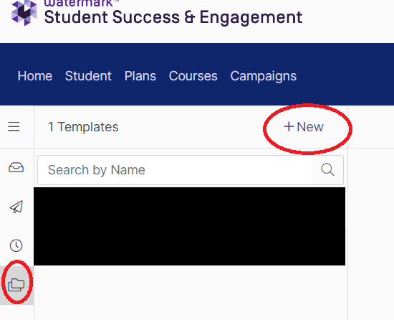


Setting up Templates in Watermark
Go to messages.
Within messages, select “Templates” and then “+ New”
Name your message template and add a subject line.
Write the body of your message
  If you copy and paste, hyperlinks will not be brought in. You will need to add a new hyperlink by using the button.
  Insert custom fields: select “field” then the information you would like the system to generate when you send a message (i.e. “student > first name”)
  Add any attachments and press “save.”
  Save communication as a note in Watermark: “Advising First, Six-, Eight-Week Check-in or Academic Planning (may include Registration)”

Slide 10

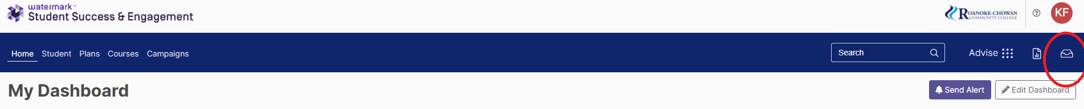
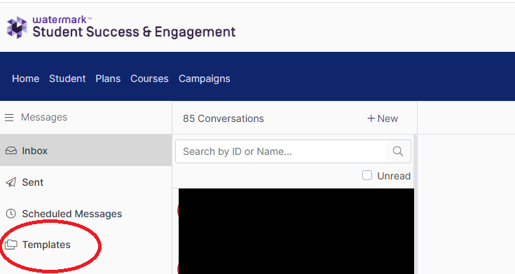
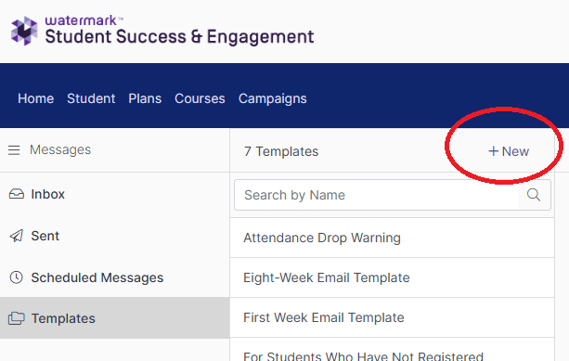
Step-By-Step Directions for Setting Up Templates (1 of 3)
Go to messages
Go to “Templates” and then click on “+New”

Slide 11
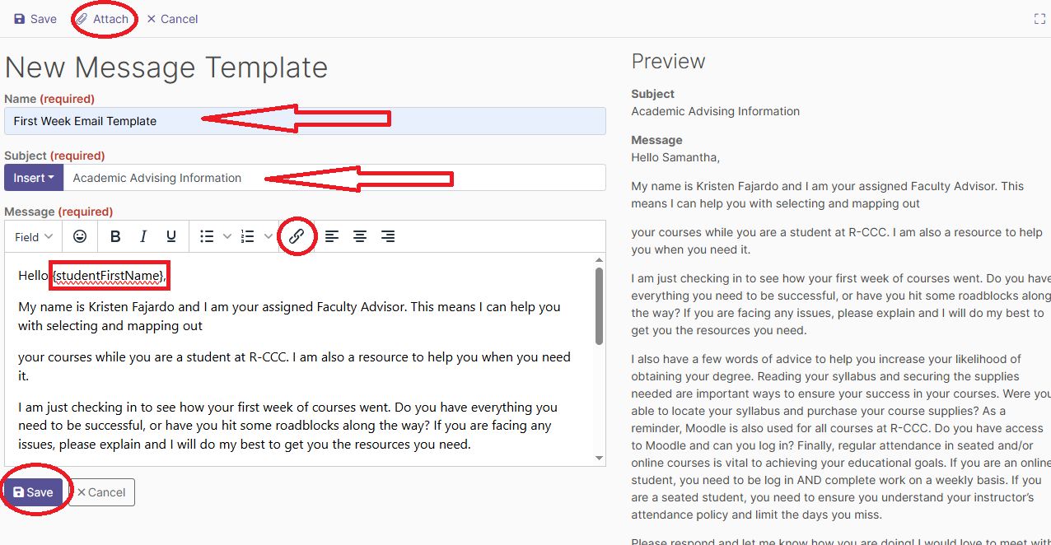
Step-By-Step Directions for Setting Up Templates (2 of 3)
Name your message template and add a subject line.
Write the body of your message
  If you copy and paste, hyperlinks will not be brought in. You will need to add a new hyperlink by using the button. (On the Six-Week Check-In email template there is a hyperlink for R-CCC’s Brainfuse)
  Insert custom fields: select “field” then the information you would like the system to generate when you send a message (i.e. “student > first name”)
  Add any attachments and press “save.”

Slide 12
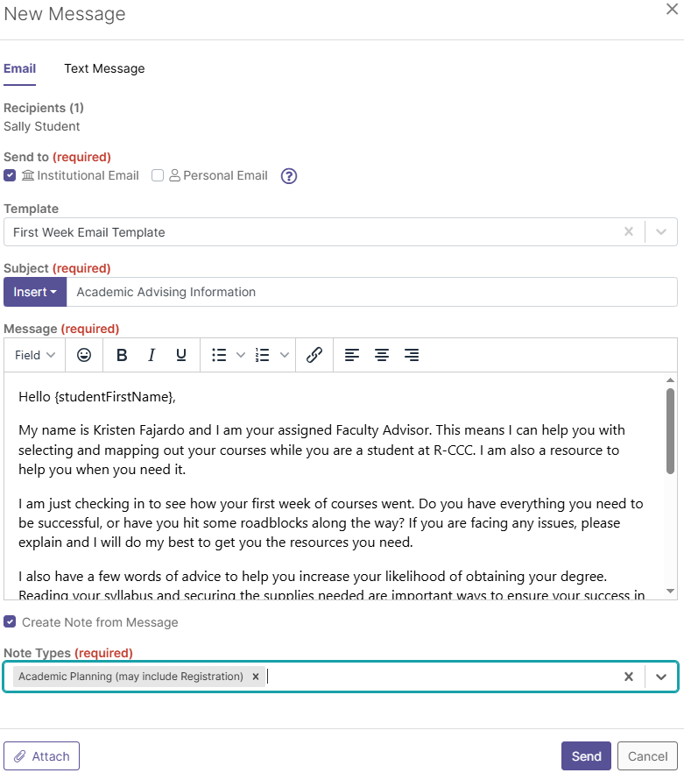
Step-By-Step Directions for Setting Up Templates (3 of 3)
  Save communication as a note in Watermark: “Advising First, Six-, Eight-Week Check-in or Academic Planning (may include Registration)”
    Check box to “Create Note from Message”
    Select Note Type from drop-down box.

Slide 13
Keep a Tally
You should be recording all your interactions with your advisees in the Watermark system as it is a general repository for others to be able to access as needed to help your advisees. Also, this information should be tallied in the count sheet for your Faculty Evaluation Plan (FEP).
  Enter a "note" in Watermark to be reported on at the end of the semester.
  Enter a "note" in Watermark when the student responds to the email.
  Use the count sheet to keep track of your emails and student responses easily.

Slide 14
Keep a Tally
Count Sheet
Semester | Timeframe | # of Advisees: | # You Reached Out To: | Number of Responses:
Fall | 1 week
Fall | 6 weeks
Fall | 8 weeks
Spring | 1 week
Spring | 6 weeks
Spring | 8 weeks

Slide 15
First Week Check-In
Reach out to advisees after the first week of class to make sure students were able to start their semester by going to their class, getting their books, logging into Moodle, etc. (See email template).
  Save note as “Advising First Week Check-in”
Keep a tally of any student who reaches back out to you from this email.

Slide 16
First Week Email Template
Subject Line: Academic Advising Information
Hello [student_first_name],
My name is [ ] and I am your assigned Faculty Advisor. This means I can help you with selecting and mapping out
your courses while you are a student at R-CCC. I am also a resource to help you when you need it.
I am just checking in to see how your first week of courses went. Do you have everything you need to be successful, or have you hit some roadblocks along the way? If you are facing any issues, please explain and I will do my best to get you the resources you need.
I also have a few words of advice to help you increase your likelihood of obtaining your degree. Reading your syllabus and securing the supplies needed are important ways to ensure your success in your courses. Were you able to locate your syllabus and purchase your course supplies? As a reminder, Moodle is also used for all courses at R-CCC. Do you have access to Moodle and can you log in? Finally, regular attendance in seated and/or online courses is vital to achieving your educational goals. If you are an online student, you need to be log in AND complete work on a weekly basis. If you are a seated student, you need to ensure you understand your instructor’s attendance policy and limit the days you miss.
Please respond and let me know how you are doing! I would love to meet with you and continue this conversation; I am committed to your success both in and out of the classroom! I look forward to hearing from you soon!
Warm Regards,
[ ]

Slide 17
Six-Week Check-In
Reach out to advisees at the six-week period to check on their progress in their classes and to see if they need support to improve a grade. (See email template.)
  Save note as “Advising Six-Week Check-in”
Keep a tally of any student who reaches back out to you from this email.

Slide 18
Six-Week Email Template
Subject Line: Academic Advising Check-In
Hello [student_first_name],
This is your Faculty Advisor, [ ]. I wanted to reach out to see how your semester is going. Are you presently facing any life changes/new situations which impact your course work?
The six-week point of a course is a good time to evaluate your goals and academic standing in the class. Have you checked your grade recently? If you are not meeting your educational goals now, I highly encourage you to visit the Tutoring & Support Section of Moodle found on every class page. There you can visit the Student Affairs and Support Module or the Brainfuse Tutoring Tool for free tutoring. You can also contact Student Services to see if you qualify for Trio Student Support Services.
Please respond and let me know how you are doing! I am committed to your success and want to see you end the semester on a high note! I am also happy to meet with you in person, by phone, or via Teams to discuss any concerns.
I look forward to hearing from you soon! [ ]

Slide 19
Eight-Week Check-In
Reach out to advisees before registration at the 8-week period. Develop or revise an ongoing academic plan with the student. Approve advisees’ classes and ask that the students go back in and register after registration opens. (See email template.)
  Save note as “Advising Eight-Week Check-in”
Put in notes for all student interactions.
Upload the academic plan into Watermark.

Slide 20
Eight-Week Email Template
Subject Line: Academic Advising and Registration Information
Hello, [student_first_name],
My name is [ ] and I am your faculty advisor, it is great to talk with you again!
Now is the time to plan your courses and register for classes for next semester. Registration for [ ] begins on [ ] for current students.
As your Faculty Advisor, I will be your contact person for the upcoming registration period and can assist you in updating your plan of study and approving courses in Student Planning to allow you to register. Since classes fill up very quickly, I want to invite you to start early and get the courses you wish to have, whether seated or online.
All students, regardless of GPA or credit hours completed, are required to contact me regarding classes. Without my approval, you will not be able to register for your courses. You may schedule an appointment with me via email at [ ] or by phone at [ ]. I am also available to meet in Teams. We can arrange for a Teams meeting by e-mail.
Before we meet, please add your course(s) in Self-Service and “request review” under “advising” in plan and schedule. Don’t forget to think about the classes you have this semester and the workload for each course. Did you take too many courses or too few? Also, are you still dedicated to your chosen major or have things changed for you?
Please contact me to review or develop your plan in person, through Teams, by email, or via phone. Together we can reserve your classes early to be sure you register for the courses, days, and times that work best for you!
Feel free to contact me at any time. I look forward to hearing from you! [ ]

Slide 21
End of Semester
At the end of the semester, Faculty Advisors will track all their advisees to make sure they have registered for the classes shown in their academic plan. Faculty will keep a record of how many students they advised, and how many registered for the classes in their plan.
Students who have not registered should be sent an email to remind them to register. (See email template.)
  Save note as “Academic Planning (may include Registration)”
Faculty Advisors will report the number of advisees they reached out to at one week, six weeks, and eight weeks and will report a tally of the advisees who reached back out to those emails. Faculty Advisors will also report the number they advised for registration and the number who registered for the classes in their plan. All of this information will be reported in the advising portion of the FEP.

Slide 22
End of Semester Email Template – For Students who have not registered
Subject Line: Time to Register for Classes – Don’t Miss Out!
Hello, [student_first_name],
My name is [ ] and I am your faculty advisor.
I hope you’re doing well! I wanted to check in because I noticed that you haven’t registered for your upcoming classes yet. Classes fill up quickly, so I encourage you to register as soon as possible to secure your preferred schedule. If you have already registered, please disregard this email—sometimes our systems take a little time to update.
As your Faculty Advisor, I’m here to assist you with updating your plan of study, selecting courses, and approving your schedule in Self-Service to ensure a smooth registration process. All students, regardless of GPA or credit hours, must contact me for course approval before registering.
Next Steps:
Add your courses in Self-Service and click “Request Review” under “Advising” in Plan & Schedule.
Consider your workload this semester—do you need to adjust your course load? Are you still confident in your major, or do we need to explore alternatives?
Schedule a meeting with me via email at [ ] or by phone at [ ]. I’m also available for Teams meetings—just send me an email to arrange a time.
Let’s work together to get you set up for success! Please reach out if you have any questions—I’m happy to help.
Looking forward to hearing from you soon!
[ ]

Slide 23
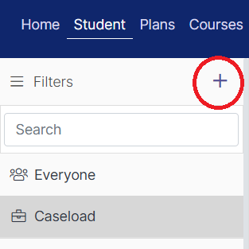
Confirming Registration
Aviso (Watermark SS&E)
Set up a filter by selecting “+” under the student tab.
Name your filter (suggested: Enrolled [current semester], not [next semester])
Choose “limit to my caseload.”
In Registration Terms Include type in and select the current semester (i.e. spring 2024).
In Registration Terms Exclude type in and select the next semester (i.e. fall 2024).
Press “save.”
View courses under “transcript” in the student profile.
  This filter will need to be updated each semester by changing the semesters in steps 4 and 5.
  Enrollments update overnight: you will not see students on this list on the same day that they register.
  It will automatically pull all students on your current caseload who are not registered for the next semester.
  This will not include past students, only those who are currently enrolled.

Slide 24
Step-by-Step Directions for Setting Up Filters on Watermark
Aviso (Watermark SS&E)
Set up a filter by selecting “+” under the student tab.
Name your filter (suggested: Enrolled [current semester], not [next semester])
Choose “limit to my caseload.”
In Registration Terms Include type in and select the current semester (i.e. spring 2024).
In Registration Terms Exclude type in and select the next semester (i.e. fall 2024).
You should also put “Graduation” in the Holds Exclude during Spring Semesters to not send messages to graduates saying they didn’t register.
Press “save.”
View courses under “transcript” in the student profile.
  This filter will need to be updated each semester by changing the semesters in steps 4 and 5.
  Enrollments update overnight: you will not see students on this list on the same day that they register.
  It will automatically pull all students on your current caseload who are not registered for the next semester.
  This will not include past students, only those who are currently enrolled.

Slide 25
Confirming Registration
Self-Service:
Select “advising,”
Search for each student individually and select “view details.
In the student profile, select “timeline.”
Courses with a “ü” are registered, all others are planned.

Slide 26
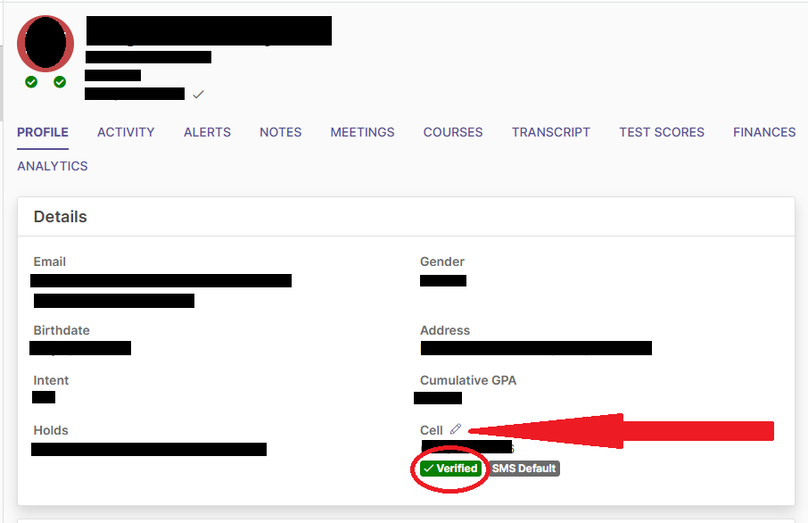
What to do if Students Aren’t Responding to Your Emails
If students are unresponsive via email, consider reaching out through Aviso (Watermark SS&E) text messaging. This is like the email messages, but you have to first verify their phone number* in Aviso (Watermark SS&E).
  Click the pencil icon to edit the phone number
  Check “Verified” once it has been verified with the student
  Go to the “Text Message” tab on the New Message pop-up.
A simple text message may be:
Hello [student_first_name]. My name is [ ], and I am your faculty advisor. I recently sent you an email regarding [topic], but I haven’t heard back from you. I wanted to check in and see if you need any assistance as you navigate your courses and scheduling here at R-CCC. Please let me know how I can help or if you’d like to set up a time to chat. I look forward to hearing from you! Best, [ ], Faculty Advisor, R-CCC.
*Please make sure you first contact the student to verify their phone number directly before you indicate it has been verified on Aviso (Watermark SS&E)
*Please note you cannot use a template for text messages.

Slide 27
New Developmental Course Track
✅ First implemented during the summer semester (2025)
✅ Fully implemented for the Fall semester (2025)
✅ Job Aid Reference Guide has been distributed by Dean Smith

Slide 28
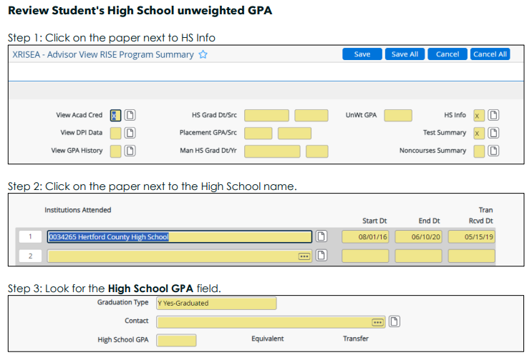
2025 Developmental Education Class Placement
Step 1: Review Student's High School unweighted GPA
  Access the student’s HSGPA in Colleague using the XRISEA XDEVEA mnemonic (updated mnemonic 3/19/25).
  If no HSGPA is available, contact the registrar or director of admissions.

Slide 29
2025 Developmental Education Class Placement
  Step 2: Determine ENG Class Placement Record
  Refer to the following criteria to place students in the appropriate English course:
  English Placement Guide
GPA | Requirements (Register for the following)
GPA ≥ 2.8 | ENG 111
GPA 2.2-2.79 | ENG 111 with corequisite ENG 045
GPA < 2.2 | ENG 025 is a prerequisite for ENG 111

Slide 30
2025 Developmental Education Class Placement
Step 3: Determine MAT Class Placement
  Refer to the following criteria to place students in the appropriate Math Course:
  Math Placement Guide 1
  Math Placement Guide 2
GPA | Requirements (Register for the following)
GPA ≥ 2.8 | MAT 143, MAT 152, MAT 110
GPA 2.2-2.79 | MAT 143, MAT 152, MAT 110 with corequisite MAT 045
GPA < 2.2 | MAT 025 is a prerequisite for MAT 143, MAT 152, MAT 110
GPA | Requirements (Register for the following)
GPA ≥ 2.8 | MAT 121 or MAT 171
GPA 2.2-2.79 | MAT 121 or MAT 171 with corequisite MAT 045
GPA < 2.2 | MAT 035 is a prerequisite for MAT 121 or MAT 171

Slide 31
Resources and Placement Tests
Students with a GPA below 2.4 may need additional support, while those with higher GPAs can also benefit from these resources to strengthen their academic progress.
  Trio Student Support Services [Bootcamps]
  Brainfuse: R-CCC Brainfuse
  GCFGlobal Math | Reading | Writing
Students without a High School GPA or Students who want to take the Placement Test
Students would take the NROC/EdReady Placement Test to place into the gateway course; otherwise, they would start with the ENG 025 or MAT 025/MAT 035 course pathway. Placement Test Contact: Director of Admissions

Slide 32
Notes
No Stacking Rule
Prerequisite courses cannot be prerequisites for one another. For example, advisors cannot require students to take both MAT 025 and MAT 035. The objective is to ensure students follow the proper developmental sequence from the beginning.
Change of Major with New Math Requirement
Students with a GPA below 2.8 who complete MAT 025 but change programs before finishing MAT 143/152 must take MAT 035 if their new program requires MAT 121/171.
Grades for New Developmental Courses
For students who place in ENG 025, MAT 025 or MAT 035, they must make a C or better to enter the gateway course. Students can only earn an A, B, C or F in those courses. If they do not score an A, B, or C, they will need to retake the course.

Slide 33
"Students don’t care how much you know until they know how much you care."
— John C. Maxwell

Slide 34
Thank You

Slide 35
Any Questions?

